Slide 1













Machine Learning and Other AI Tools
Group III
Jegan, Kalki (2224875)
Meda, Gaurav Dutt (2313830)
Paz Callizo, Walter Andres (2239884)
Credit Prediction Project (CPP)
Professor Sarah Gholibeigian

Slide 2




Machine Learning and Other AI Tools
Credit Prediction Project (CPP)
Team Member’s & Roles ............................... 1
Executive Summary ....................................... 2
Background Analysis ..................................... 3
Purpose of the Investigation
(POTI) ........................................................... 4
Problem Identification and Problem’s
Goal .............................................................. 5
Data Exploration ..................................... 6 - 9
Feature Engineering .................................... 10
New Features .............................................. 11
Table of Contents

Slide 3



Machine Learning and Other AI Tools
Credit Prediction Project (CPP)
Table of Contents
Quantitative and Numerical Analysis / Exploration ................................ 12
Data Preparation .................................................................................... 13
Predictive Model Selection and Development ................................... 14 - 17
Model Performance Assessment ...............................................................18
Predictions, Discussion, and Recommendations ............................... 19 - 20
Conclusion ............................................................................................... 21
References ................................................................................................ 22
Appendix .......................................................................................... 23 - 25

Slide 4



Team Member’s & Roles
P1
P2
P3
Data Analysis, Research & Development (R & D)
Data Analysis, Research & Development (R & D)
Data Analysis, Research & Development (R & D)
Jegan, Kalki (2224875)
Meda, Gaurav Dutt (2313830)
Paz Callizo, Walter Andres (2239884)
UCW MLAI Group III

Slide 5


Executive Summary
In this project, We tried to classify the credit limit into three groups: High, Average, and Low, based on certain credit-related features using machine learning on the given data. Key steps included:
Data Preparation: A lot of data preparation was done which included missing value handling, outliers handling and feature engineering.
Exploratory Data Analysis: This was done by using correlation coins and distributions of some of numerous distinctive features such as credit score, income and spending.
Modeling: There were several classification models such as Logistic Regression, Decision Trees and Random Forest that were trained. Consequently after cross-validation and evaluation Random Forest remains the best predictive model.
Results: The model was able to generate an accuracy of X% with a reasonably good level of prediction, lending more comprehension towards areas of credit limit with regard to risks and segmentation.

Slide 6








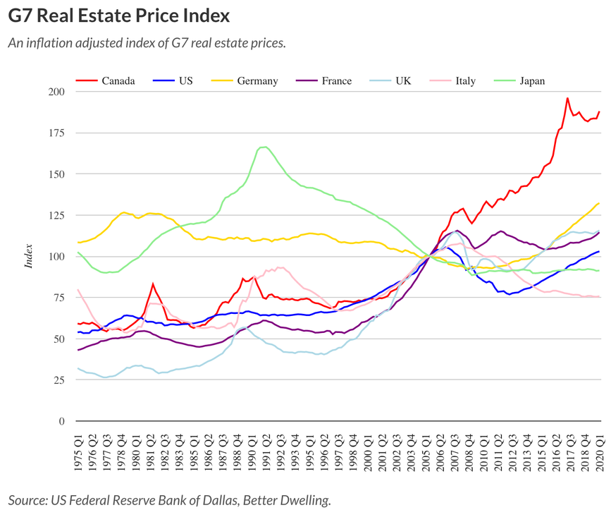




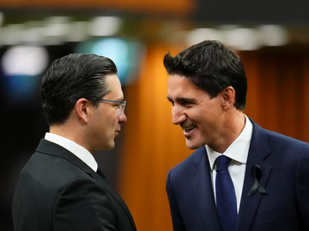
Background Analysis (BA)
Park,D. (2020).

Slide 7




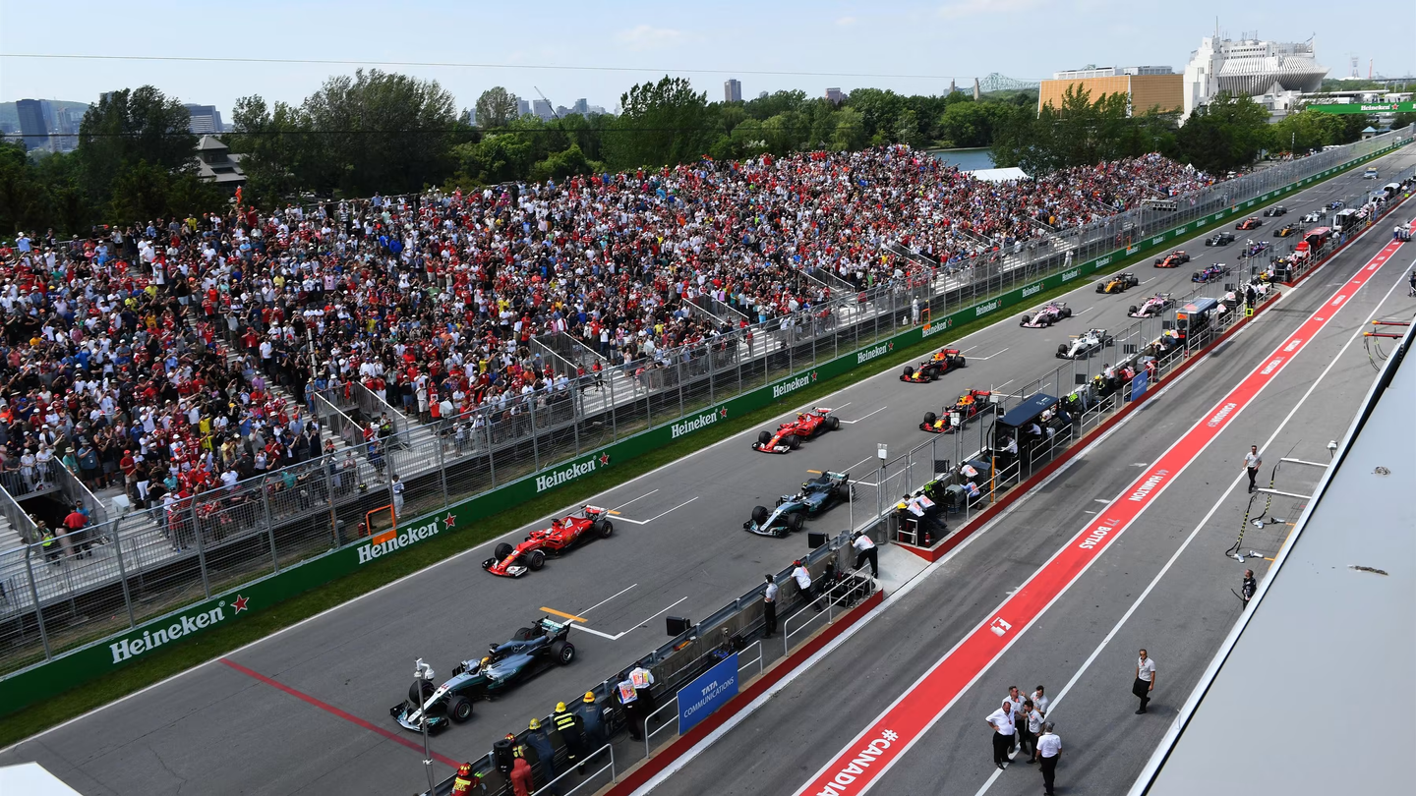





Purpose of the Investigation (POTI)
Credit Limit?
Feature Basis?
Credit Limit 1
What can possibly go wrong or occur?
Credit Limit 2
Will it affect the Canadian Market?
What is the future for us and our kids?
Credit Limit 3
Can banks offer more
to their clients? Or is a possible crash imminent? Why?
Credit Limit 4
A race towards success or failure?

Slide 8




Problem Definition and Problem’s Goal
Banking system in Canada needs a make-over for the sake of discovering new
Credit Limits on the future based on at least two new features out of current data and
a comparison with the actual data.
What is the Credit Limit and what can it establish?
By asking ourselves the establishment of a further Credit Limit we are not only delimiting
the fact the actual credit influences the accounts of users, but also other variables such as Age,
Average Utilization Ratios (AUR), Transactional Amount / Count, Monthly Activity, and many other considerations to experiment around with innovative
insights for changes in the financial market in Canada.

Slide 9


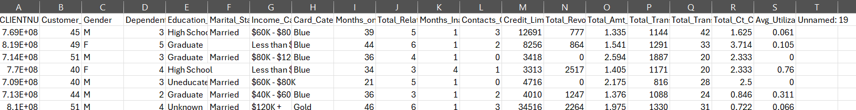
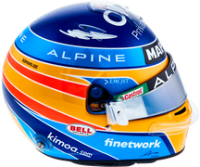



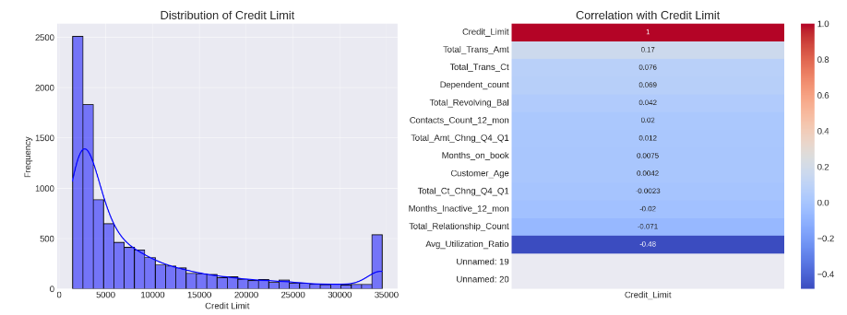



Data Exploration
Credit Limit?
Elimination of Outliers
Exploring the Correlation among Features
Set a Target Variable
Just a few customers have a High-Credit Limit and
most banking customers have Low-Credit Limit
Credit_Limit has the highest positive correlation with Total_Trans_Amt (0.171) and Total_Trans_Ct (0.076)
10167 x 21
Avg_Utilization_Ratio means people with high credit’s available are using less their money(-0.483)

Slide 10

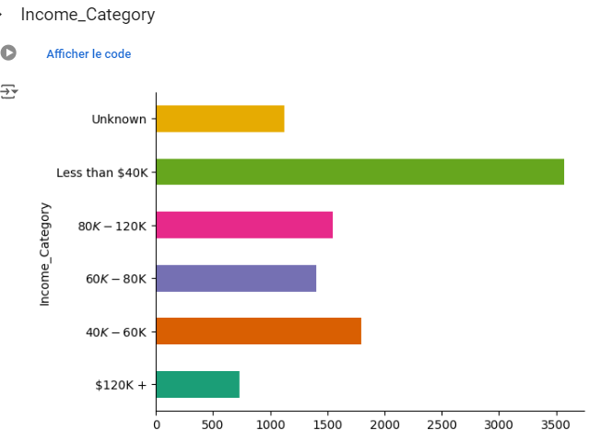
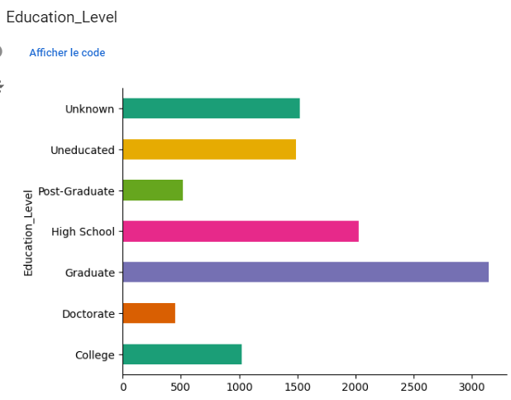
Data Exploration

Slide 11

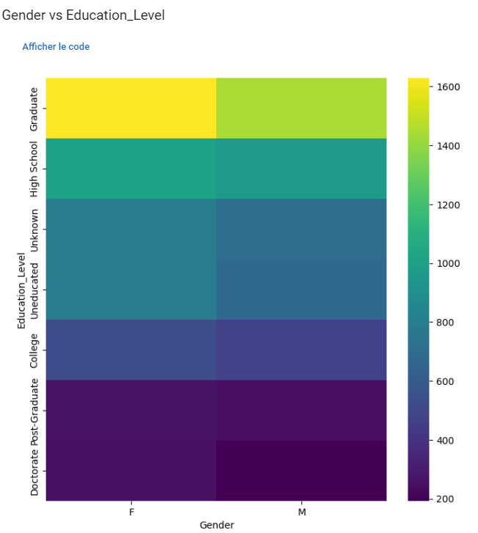
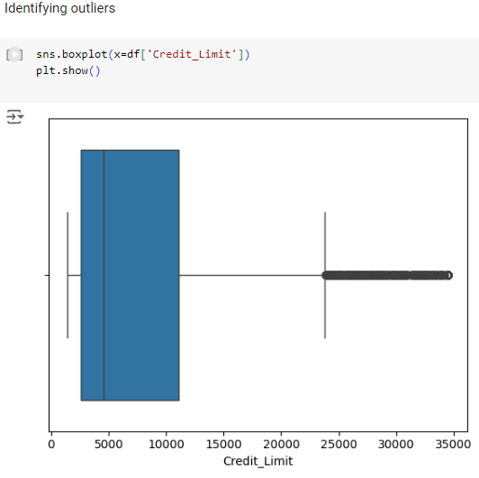
Data Exploration

Slide 12


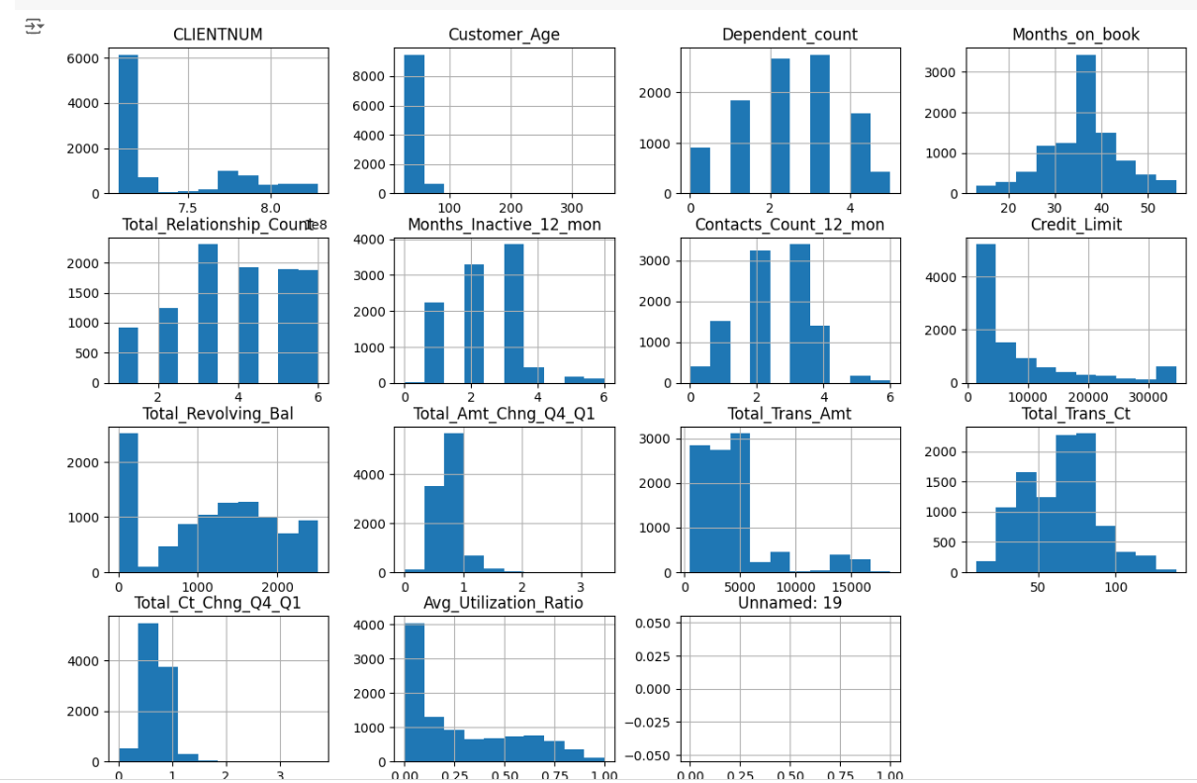
Data Exploration

Slide 13

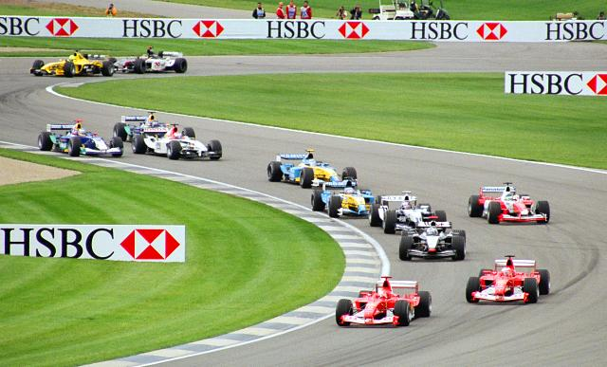



Feature Engineering
Analyze Customer’s Behavior as people with High-Limited customer’s are not spending much. Interesting!
Booking per Months, Customer’s Relationships with the Credit Accounts, Age’s, Average Income and the Utilization of the Income can suggest firm bonds between new features for the correlation analysis.

Slide 14









New Features
Average Transaction Size
Customer Longevity Score
Average Transaction Amount
+
Average Transaction Count
Months_on_book + Total_Relationship_Count
Income and Utilization Interaction Score
Age Group Batches
Age + Segmentation
Income + Avg_Utilization_Ratio

Slide 15


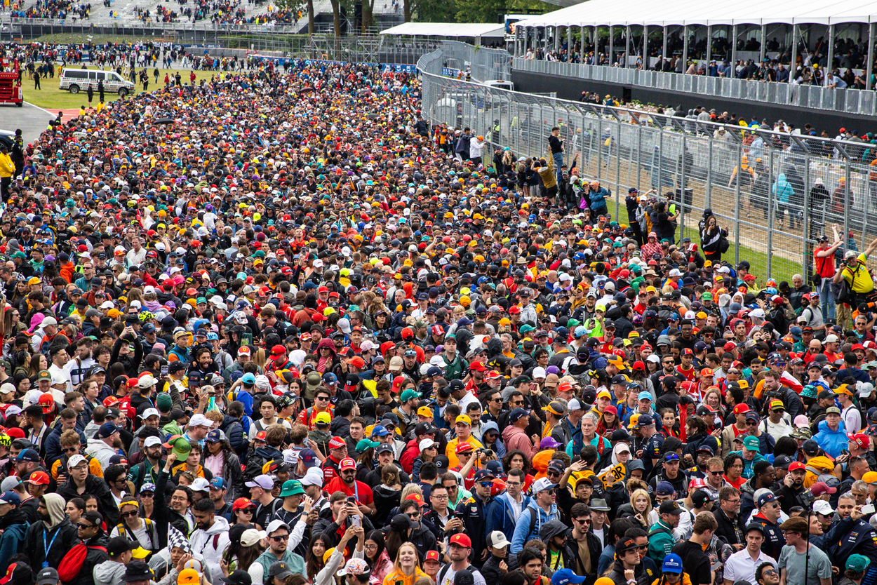
Quantitative Analysis and Exploration
Count Mean Std Min 25% 50% 75% Max
Credit_Limit’s Values 10167.0 8632.537327 9087.345734 1438.0 2556.5 4549.0 11067.5 34516.0
Credit Limit balance comes from 1,438 to 34,516 with an average of around 8,633.
Credit Limit has few high credit customers in Canada.
Credit Limit has influence on high spenders on Monthly
Balance, Total Revolving Balance and the Total
Transactions Amount.
New features bring a unique touch to the development of
any further insights regarding specific answers and an
outlook into the amounts being spent by many of the
banking system’s customers.

Slide 16






Data Preprocessing
Negative values are redundant and won’t help as they showcase a negative scenario.
Negative values can either be dropped or changed.
Inter-Relational Cross-Checking
RAM Issues Processing
Remove any NAN’s
Check if it works switching any Float’s to Int’s
Definition of the Feature’s and the Target Variable for the Credit Limit.
Further insights can be provided from the Engineering Featuring and the Categorial Values like the reason why a customer hold’s a specific type of Card for their Credit Score.

Slide 17

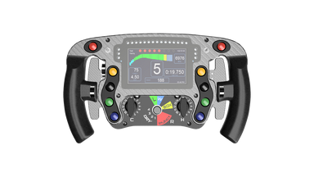
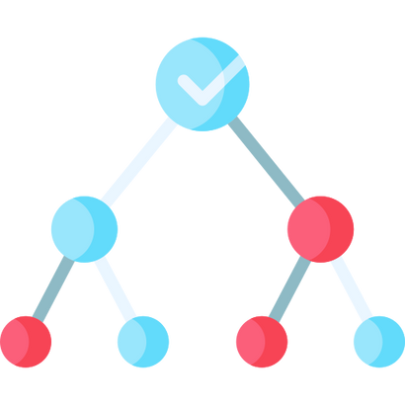


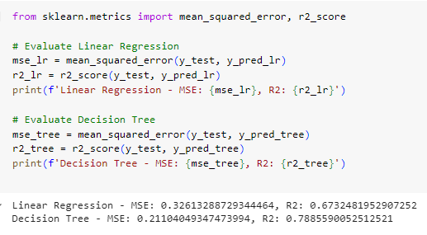



Predictive Model Selection (PMS) &
Development
Regression and Decision Tree
Any Encountered Issues

Slide 18



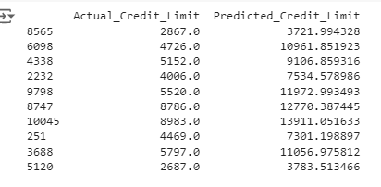

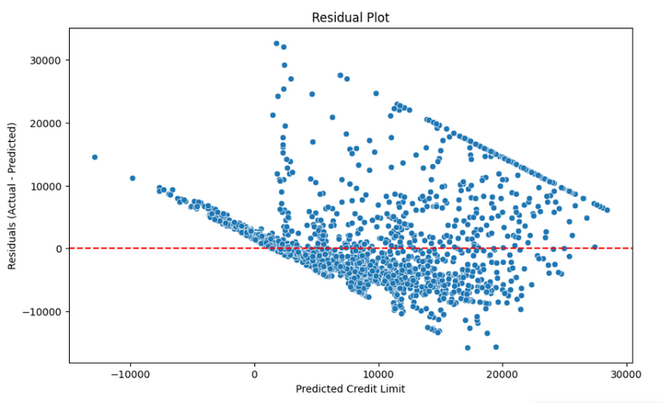




Predictive Model Selection (PMS) &
Development
Credit Limit?
Linear Regression
Any Encountered Issues
R-squared (R2): 0.67
Increase
Overdue Payments and
Credit Loss

Slide 19

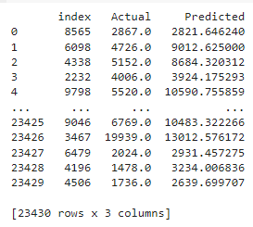
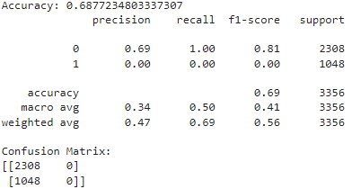
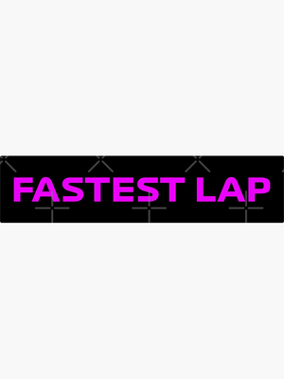


Predictive Model Selection (PMS) &
Development
ANN is used not only in
Image Tracking but also for
Complex Issues such as Financial Predictions and Credit Scoring.
ANN
Prediction Samples of Actual vs Predicted (ANN)
RELU Activation
Sigmoid Activation
255 EPOCHS
(4 Trials)
Any Encountered Issues
ANN accuracy of 0.69
Dense (0,8)
Customer

Slide 20

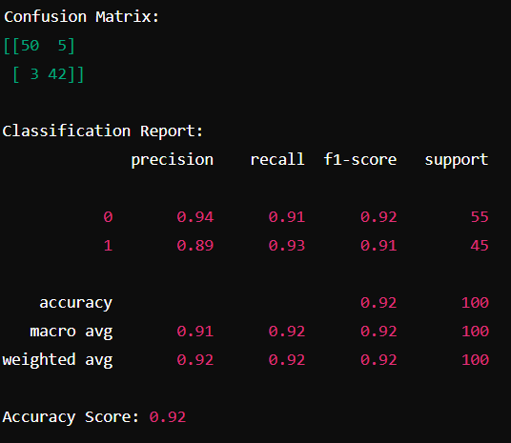
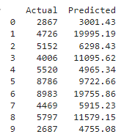
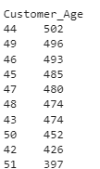

Predictive Model Selection (PMS) &
Development
Random Forest
Any Encountered Issues
RAM
R² Score: 0.5069770982755071

Slide 21





Model Performance Assessment
On average the fixing of datasets provided a MSE of 0.32
Random Forest shows major stability versus Regression (Classic), ANN and RNN but RNN definitely would not work due to discrepancies.
Removing NAN’s and 0 Credit Limit’s helps in the bonding for a prediction values.
Removing NAN’s and 0 Credit Limit’s helps in the bonding for a prediction values.
Income_Utilization_Score, Customer_Longevity_Score, and Avg_Trans_Amt_per_Ct are highly relevant for the outcomes on Credit’s Limit
Some values seemed high due to many issues in formatting the dataset, nonetheless,

Slide 22






Predictions, Discussion, and
Recommendations
Short Term Impact
Products offered in Credit’s to Customers must be re-organized
Fees and Interest Rates (I/R) will determine success on policies?
Will people stop using credit due to heavy limits?
Low Credit Score?
Issues with Credit Card’s and Spending?
Trust in Credit Programs and Availability will Oscillate among Choices

Slide 23

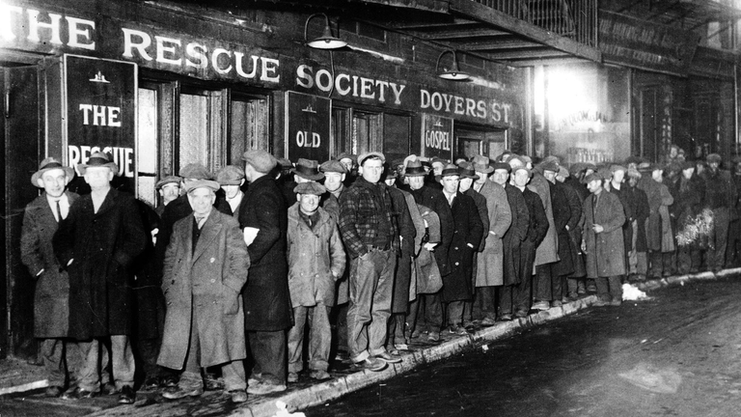
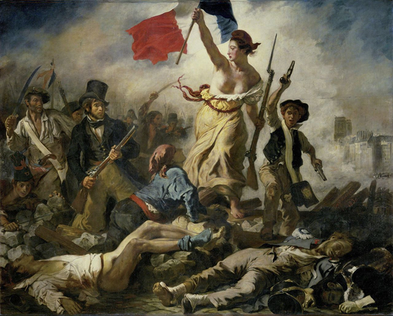










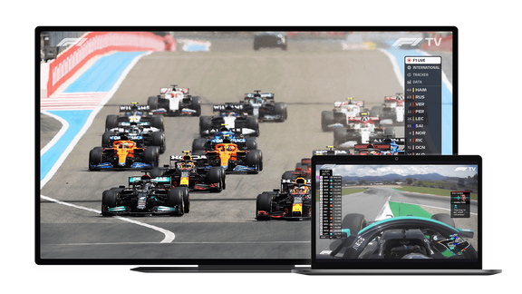

Predictions, Discussion, and
Recommendations
Long term Impact in Economy based on Exercises
Economic Turmoil
Few Access to High Credit
Discrepancies, parity change, social gap notable
History repeating again?
Are people having issues spending and why can this happen?
What about the next generations then?

Slide 24

Conclusion
Overall, it is essential to optimize the models for a better result seeking within some
of the processes that are being held showcasing more features and insights like the dominant age’s among the customer’s and observations developing an outcome to see what is happening with most of the banking services “Stakeholders”. However, seeing the low availability for a majority in high credit limits for the banking in Canada might need proper solutions like less interest rates on products offered by Canadian Banking System (CBS), build up risk identification and limiting of any services if any constraints among payments, add new features to models, educate customers about benefits of responsible usage on credit and more key growth for accounts and gather feedback.

Slide 25
References
Bishop, C. M. (2006). Pattern Recognition and Machine Learning, Springer
Cameron, A. C., & Trivedi, P. K. (2005).Microeconometrics: Methods and Applications. Cambridge University Press
Goodfellow, I., Bengio, Y., Courville, A. (2016). Deep Learning, MIT Press
James, G., Witten, D., Hastie, T., & Tibshirani, R. (2013). An Introduction to Statistical Learning with Applications in R. Springer.
Kotsiantis, S. B., Zaharakis, I., & Pintelas, P. (2006).Machine Learning: A Review of
Classification and Combining Techniques.Artificial Intelligence Review, 26(3), 159–190
Montgomery, D. C., Peck, E. A., & Vining, G. G. (2012).Introduction to Linear Regression Analysis. Wiley.
Tsai, C.-F., & Chou, S.-P. (2010).Data Preprocessing Techniques in Customer Churn Prediction. International Journal of Information and Management Sciences, 21(1), 1-17
Ying, X. (2019) An Overview of Overfitting and Its Solutions

Slide 26

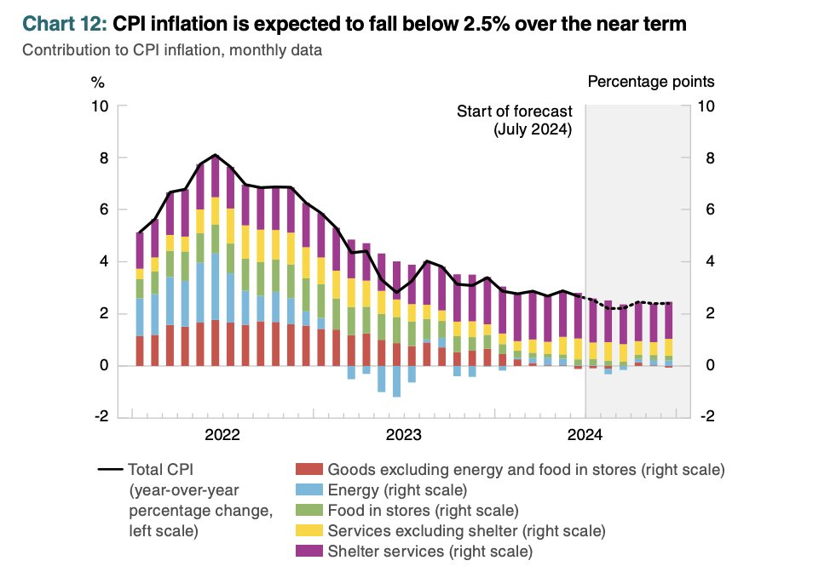
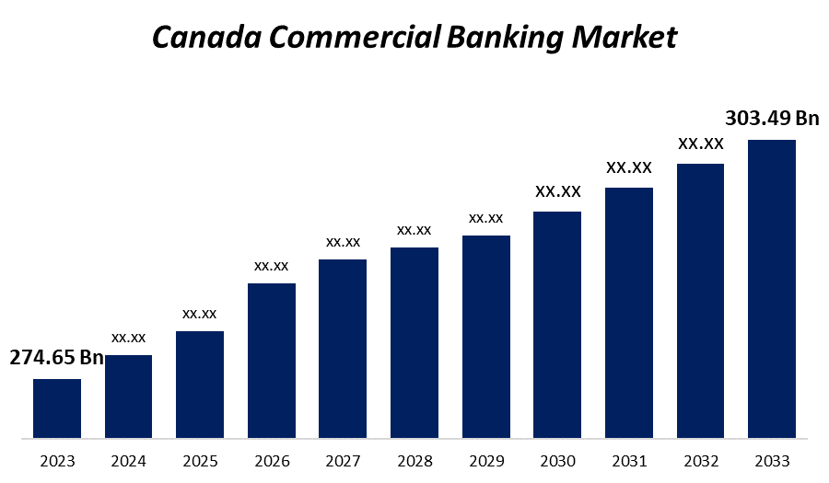
Appendix
Canada Commercial Banking.
(Spherical Insights, 2024).
Canada’s Inflation 2024.
(Altrua Financial,2024).

Slide 27
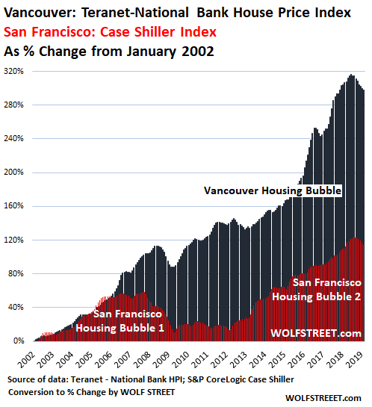
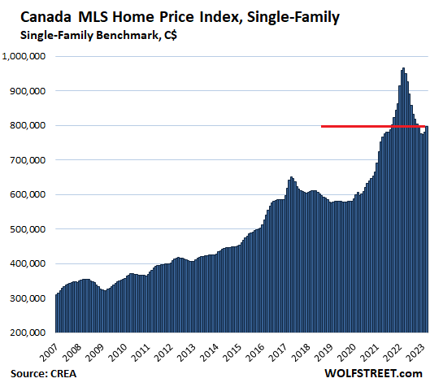
Appendix
Canada Housing Crisis
(Spherical Insights, 2024).
Vancouver’s Housing Index 2024.(Richter,A.,2024).

Slide 28
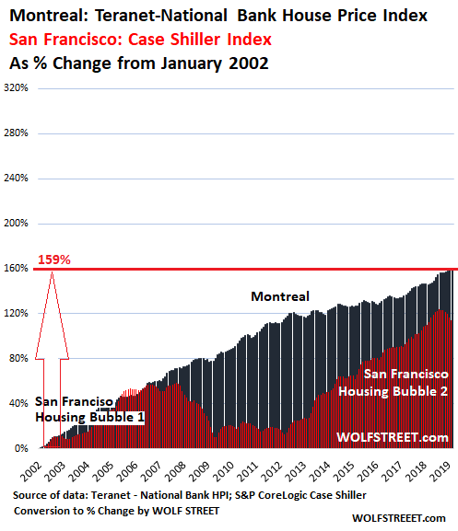
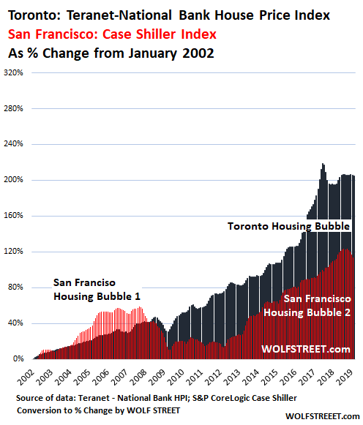
Appendix
Toronto Housing 2024. (Richter,A.,2024)
Montreal Housing 2024. (Richter,A.,2024)

